Slide 2
In 1889 Ludwig Wittgenstein was born into an extremely wealthy family…

Slide 3
…in Vienna.

Slide 4
His father, Karl, was a businessman who wanted sons just like himself.

Slide 5
2 of his 5 sons committed suicide because of the paternal pressure. But the Wittgensteins were also patrons of the arts.

Slide 6
Brahms performed at their house.

Slide 7
Klimt painted his sister’s wedding portrait…

Slide 8
…and then Freud analyzed her!

Slide 9
Ludwig was the youngest in the family.

Slide 10
Wittgenstein studied engineering in Berlin, and then aeronautics in Manchester.

Slide 11
He even patented a propeller.

Slide 12
From his scientific work he became interested in mathematics…

Slide 13
…and then in Logic.

Slide 14
So he went to study with the famous logician & philosopher Bertrand Russell…

Slide 15
…at Trinity College, Cambridge, in 1911.

Slide 16
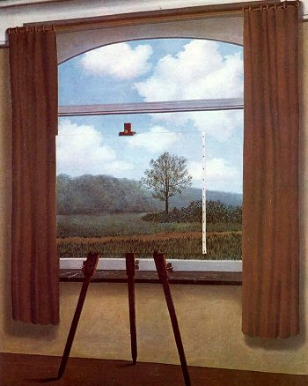
He thought about how language can be about the world…

Slide 17
…and what logic is about.

Slide 18
After two years he felt he had learned all he could at Cambridge. So he moved...

Slide 19
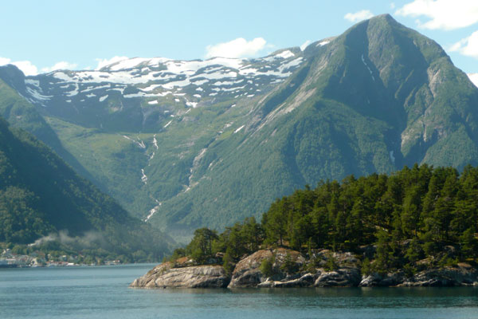
…to Norway…

Slide 20
…where he could be alone.

Slide 21
He built a small house for himself and set to work on a book.

Slide 22
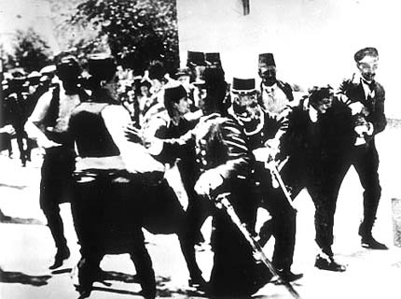
In August of 1914 war broke out in Europe and, despite having a medical deferment, Wittgenstein joined the Austro-Hungarian army.

Slide 23
He wanted to put himself to the test spiritually.

Slide 24
He asked to be sent to the front, where he served as an artillery observer.

Slide 25
Even in these dire circumstances he worked on his philosophy.

Slide 26
And he won a medal for bravery.

Slide 27
By the end of the war he had written his book…

Slide 28
…called the Tractatus Logico-Philosophicus.

Slide 29
In addition to conclusions about language and the world:
4.021 A proposition is a picture of reality.
4.1212 What can be shown, cannot be said.

Slide 30
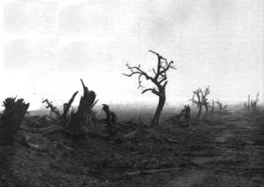
He also commented on his wartime experiences:
6.373 The world is independent of my will.
6.4311 Eternal life belongs to those who live in the present.

Slide 31
The infamous final sentence was:
“Whereof one cannot speak, thereof one must be silent.”

Slide 32
So he left philosophy and went off to teach elementary school in rural Austria.

Slide 33
Wittgenstein’s father had died in 1913, and he stood to inherit a fortune, but he refused it.

Slide 34
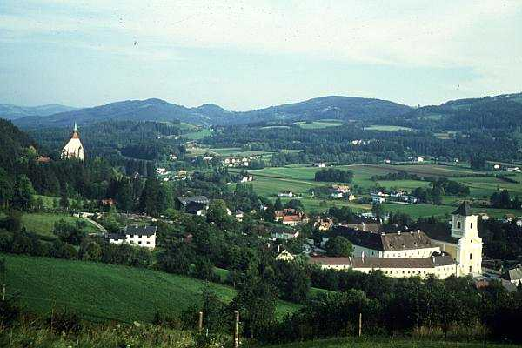
Ludwig taught in various villages for 6 years, but he was not cut out for teaching children, & he finally quit.

Slide 35
He moved back to Vienna and helped design a house...

Slide 36
…for his rich sister.

Slide 37
In the 10 years since he had written his book, he decided it had mistakes, and he returned to Cambridge to try again.

Slide 38
John Maynard Keyes said: “God has arrived. I met him on the 5:15 train.”

Slide 39
He realized language had many uses other than just representing the world:
Giving orders or making requests.
Telling jokes or stories.
Asking for guidance, or offering it.
Formulating a hypothesis.
Thanking, cursing, greeting, praying…

Slide 40
He called these “language games.”

Slide 41
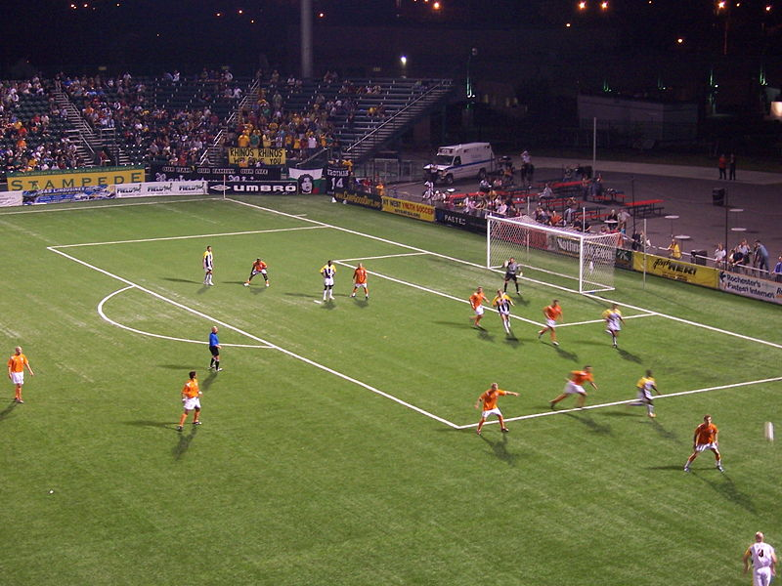
Watching a soccer match once he thought: we play games with words.

Slide 42
Wittgenstein began teaching classes at Cambridge in 1930.

Slide 43
But he soon realized how different his students were from him.
“This book is written for such men as are in sympathy with its spirit. This spirit is different from the one which informs the vast stream of European and American civilization in which all of us stand.”

Slide 44
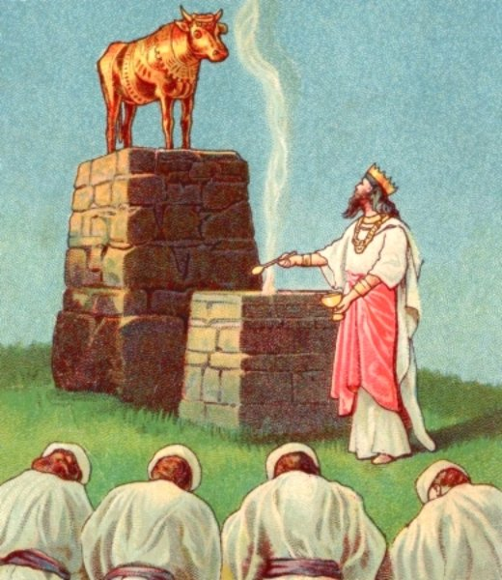
He opposed the worship of science as an idol or ideal.

Slide 45
He valued describing over explaining.
“People who are constantly asking ‘why’…

Slide 46
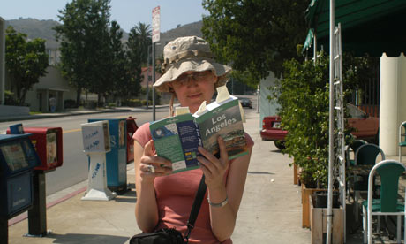
…are like tourists who stand in front of a building, reading Baedeker, & through reading about the history of the building’s construction are prevented from seeing it.”

Slide 47
“Don’t think, but look!”

Slide 48
He advocated a surprising view of philosophy:
“The results of philosophy are the uncovering of one or another piece of plain nonsense and of bumps the understanding has got by running its head up against the limits of language.”

Slide 49
and:
“A philosophical problem has the form: ‘I don’t know my way about’.”

Slide 50
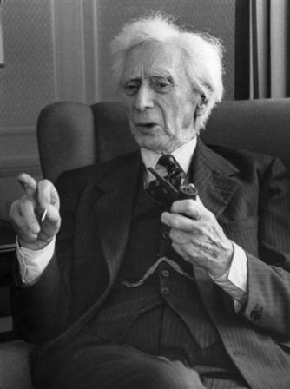
Wittgenstein’s old teacher, Bertrand Russell said of Wittgenstein’s later ideas:
“He seems to have grown tired of serious thinking and to have invented a doctrine which would have made such an activity unnecessary.”

Slide 51
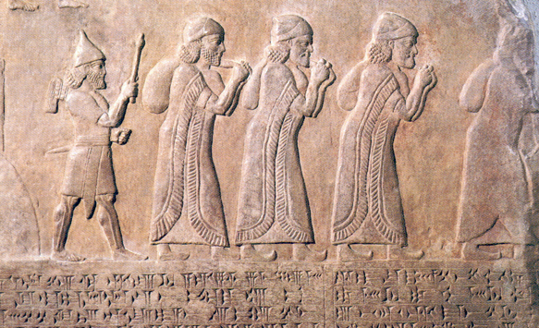
Wittgenstein always felt like an outsider, an exile:
“I have to live with people to whom I cannot make myself understood…. Feel myself now very alien here.”

Slide 52
For a time he returned to his hut in Norway.

Slide 53
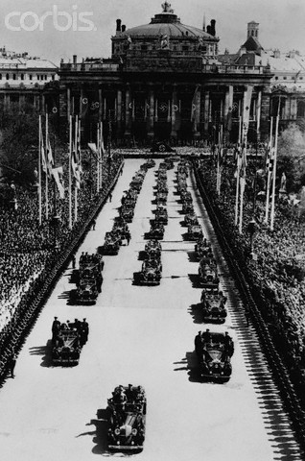
But when the Nazis annexed Austria he needed British citizenship.

Slide 54
So he reluctantly returned to teaching and became the Professor of Philosophy at Cambridge.

Slide 55
During the war he did medical work in London and Newcastle.

Slide 56
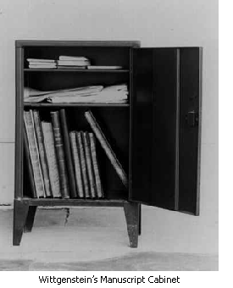
After the war he finally resigned his teaching position to finish his book.

Slide 57
He moved to Western Ireland to again be alone...

Slide 58
…but he never completed his new book to his satisfaction.

Slide 59
He was diagnosed with cancer. Upon being told that his friends would arrive to see him the next day, his last words were…

Slide 60
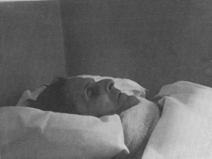
“Tell them I had a wonderful life.”

Slide 61
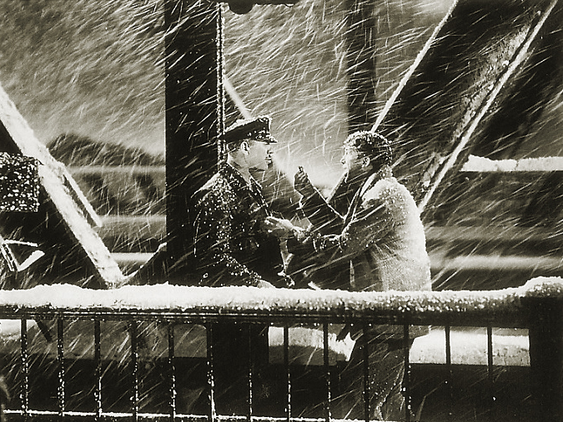
This has puzzled philosophers and those who knew him.

Slide 62
Wittgenstein died in 1951.

Slide 63
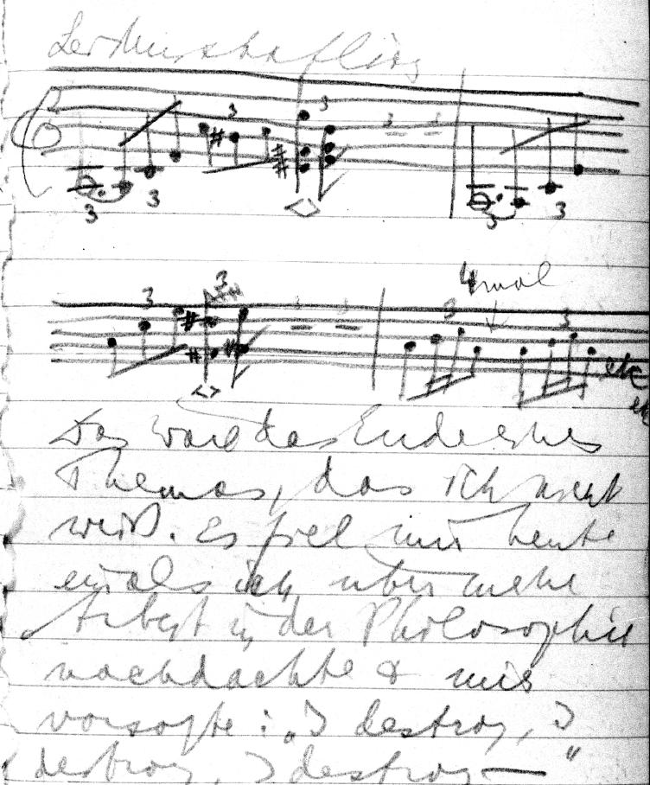
He left behind about 20,000 pages of unpublished work.

Slide 64
His book was finally published by his friends in 1953.

Slide 65
The preface concludes:
“It is not impossible that it should fall to the lot of this work, in its poverty and in the darkness of this time, to bring light into one brain or another—but, of course, it is not likely.”

Slide 66
It is considered by philosophers to be the most important philosophical book of the 20th Century.

